Slide 1

Chapter 1
Sequence
Notes:
In this first chapter of Python, we define the first building block of programming, the sequence

Slide 2
Content
Back in time...
Why Python?
The concept of sequence
Getting to know PyCharm
Variables and their data type
Conversion functions
Operators
Functions print() and input()
Notes:
Before starting with the sequence we go back in time and explain why we have chosen for Python as programming language.

Slide 3
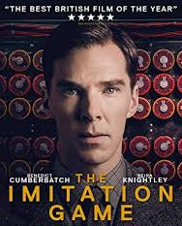
Going back in time...
First computers were "fixed program computers"
This means machines that can run 1 specific program or algorithm
Most famous example is Alan Turings machine which was able to crack the Enigma code of the Germans during the 2nd World War.
Notes:
The first computers go back till the early 30’s and were called ‘fixed program computers’, able to run 1 specific program.

Slide 4
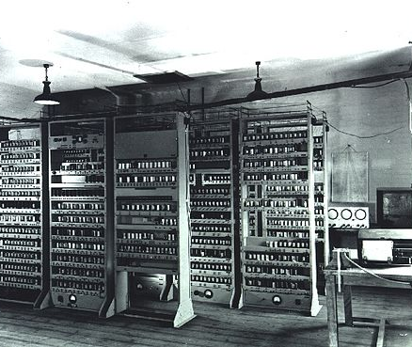
Going back in time...
A breakthrough came with the invention of the "Stored program computers".
Not only the data but also the algorithms are stored in the memory of the computer
In addition, these computers were equipped with a processor or CPU
The CPU is responsible for carrying out calculations and checking the instructions to be carried out sequentially.
This type is known as the Von Neumann machine with as first example the Electronic delay storage automatic calculator (EDSAC) developed in Cambridge
Notes:
Later on, ‘stored program computers’ were invented, able to not only store data but also the algorithms. Moreover these computers were equipped with a processor.

Slide 5
Going back in time...
Each processor has its instruction set or collection of machine codes that can be processed.
Modern processors process up to a few hundred thousand MIPS (Million Instructions Per Second).
Because it is time consuming to write and maintain the instructions to be executed in machine code, assembly and programming languages have been developed.
In assembly languages, each line represents an instruction in machine language
In programming languages the actual machine language is abstracted and encoded in a clear, legible and transparent way
MOV cx,12 Move or place 12 in register cx
number = 12
Notes:
Back than each processor had its own machine code. Maintaining and writing this code was very time consuming. Therefore, assembly and program languages such as Python have been developed. Those programming languages are easier to understand. For instance number equals 12, we assign the value 12 to the variable with the name number.

Slide 6
Going back in time...
The best known higher programming languages
1957 | FORTRAN | Formula Translation, developed by John Backus
1959 | COBOL | Common Business Oriented Language, developed by Grace Hopper
1964 | BASIC | Beginners All Purpose Symbolic Instruction Code, developed by Darmouth College students and refined by Bill Gates and Paul Allen.
1969 | C | Developed by Dennis Ritchie at Bell Telephone as the successor of B to drive the Unix Operating System. Linux is based on C.
1970 | PASCAL | Developed by Niklaus Wirth for educational purposes. The language is named after Blaise Pascal who invented the first 'calculator' in 1641.
1983 | C++ | Bjarne Stroustrup of Bell Labs expands C into an object-oriented language.
1987 | PERL | Practical Extraction Reporting Language, developed by Larry Wall. Perl was Wall's reaction to the fact that a number of standard reports with existing Unix commands could not be realized.
Notes:
At the following slide you can find a list with programming languages.

Slide 7
Going back in time...
1991 | PYTHON | Developed by Guido van Rossum, working in "Centre for Mathematics and Computer Science" in the Netherlands as an extension to the language 'ABC'. Python owes its name to Monty Python, Guido van Rossum's favourite TV program.
1992 | VB | Visual Basic. Language released by Microsoft for building graphical window applications.
1993 | RUBY | Yukihirio Matsumoto developed Ruby by combining the languages Perl, Ada, Lisp, Smalltalk and Eiffel.
1995 | PHP | Rasmus Lendorf developed PHP to replace a number of Perl scripts that supported his homepage.
1995 | JAVA | Developed by Sun Microsystem developers led by James Goslin.
1995 | JAVASCRIPT | Developed by Brendan Eich of Netscape under the name Mocha. Language for client-side scripting. Is based on C and is not related to Java.
2001 | C# | Developed by Microsoft as part of .NET. C# is object-oriented and is Microsoft's response to Java.
Notes:
Note, that Python was developed in 1991 by Guido van Rossum and was named after his favourite series Monty Python.
Java the programming language which will be taught in the spring semester was developed in 1995.

Slide 8
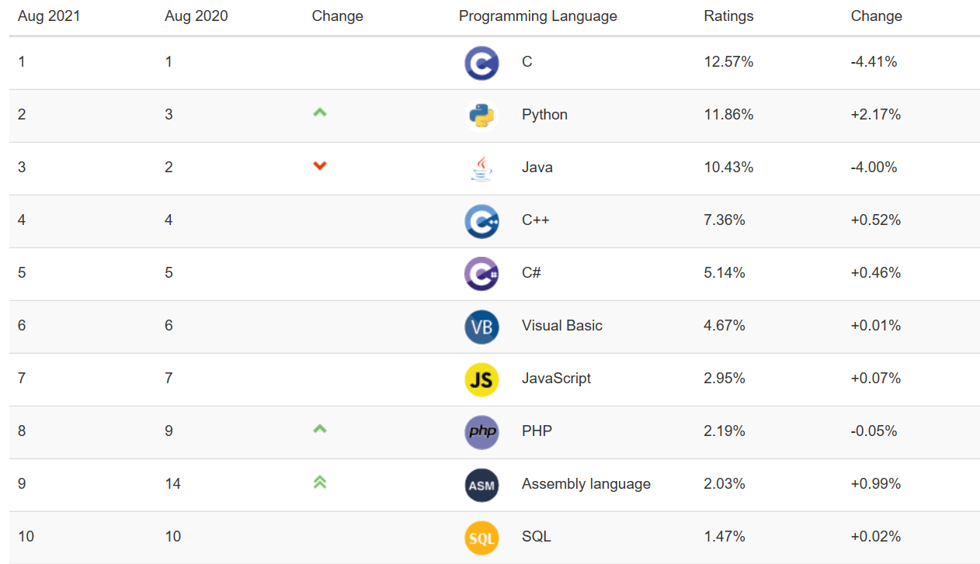
Most popular programming languages today
The TIOBE-Programming Community index reflects the popularity of programming languages.
Notes:
Note that Python has received a bronze medallion since August 2020 as third most popular programming language.

Slide 9
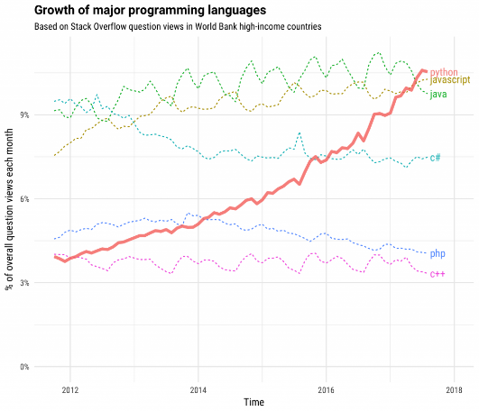
Use of Python
2017, 'Python' was the most frequently entered tag on Stack Overflow.
The rise of Python is impressive as Python was still at the bottom of the top 5 in 2012.
Notes:
The following chart also shows the rise of Python.

Slide 10
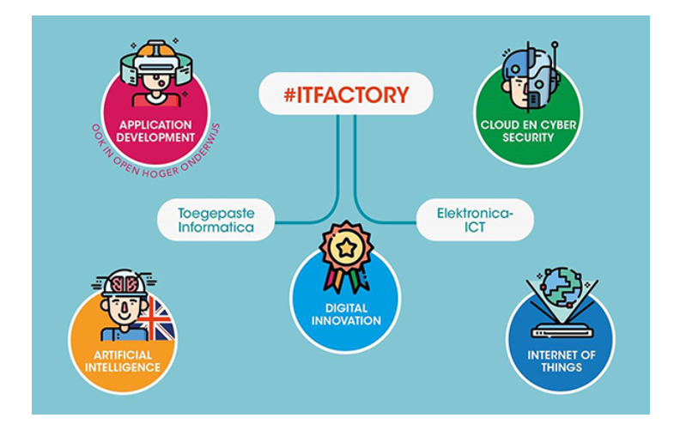
Why Python @ IT Factory?
Python is a general-purpose programming language!
Python is one of the favorite languages used by IOT developers. Students program in Python on minicomputers like the Raspberry Pi.
Python is getting a bigger and bigger footprint in the world of Data Science. Artificial Intelligence (AI) and Machine Learning tools are increasingly being built with Python. For example, Tensorflow, Google's Deep Learning framework, is written in Python.
Notes:
Why do we teach Python in our program? Python is useful for all our pillars such as Application Development, Cloud and Cyber Security, Artificial Intelligence and Internet of Things. In the second year of our program you will have to chose a specific pillar. We program the Raspberry PI and we can built AI and Machine Learning Tools using Python.

Slide 11
Why Python @ IT Factory?
Python is a general-purpose programming language!
Hacking and cracking tools developed in Python are used by system administrators to identify weaknesses in network security. Python scripts are also written for the management of servers.
Many large software applications are written in Python. Think Spotify, Youtube and Pinterest. A large part of the Google spider software is written in Python. Yahoo uses it for their Yahoo Maps. But Disney also uses Python to render animation films.
Notes:
We secure our network and develop software applications using Python.

Slide 12
Why Python @ ITFactory?
The programming language in this course is Python but the purpose of the course is not to highlight all of Python's features.
The focus of this course is on general basic programming concepts that are valid within any programming language.
After all, each program is a combination of the following building blocks:
Sequences
Selections
Iterations
Methods/Functions
These building blocks are explained and practiced in Python.
In this chapter we start with the building block 'Sequence'.
Notes:
We will use Python to teach you the general basic programming concepts which can be used within any other programming language such as e.g. Java and C#. The aim of this course is not to show you all bells and whistles of this programming language. The concepts that will be discussed are the sequence, the selection, the iteration and the functions.
To explain these concepts we start with a presentation followed by exercises. All the material is available at Canvas.
In this chapter we start with the concept: 'Sequence'.

Slide 13
Sequence
Each program consists of a sequence of steps or statements to be performed.
When the program executes each of these statements one after the other, we call it a sequential program.
You can compare this way of coding with following a recipe from a cookbook. You carry out all the steps (weighing ingredients, melting butter, mixing, baking, ...) one by one.
statement
statement
statement
Notes:
A sequence is a structure which executes each statement one after the other. Starting with step 1, then step 2 and so on.
Similar to cooking where you start with weighing your ingredients, secondly, you melt the butter, thirdly you mix… and so on, step by step, one after the other.

Slide 14


Getting to know PyCharm
Pythons standard IDE (Integrated Development Environment) is IDLE.
In this course we use a more extensive environment, PyCharm.
You can download PyCharm at https://www.jetbrains.com/pycharm/.
Notes:
On the market many SW tools are available to built Python programs, we have decided to use the open source program PyCharm. You can download the SW via the link.

Slide 15
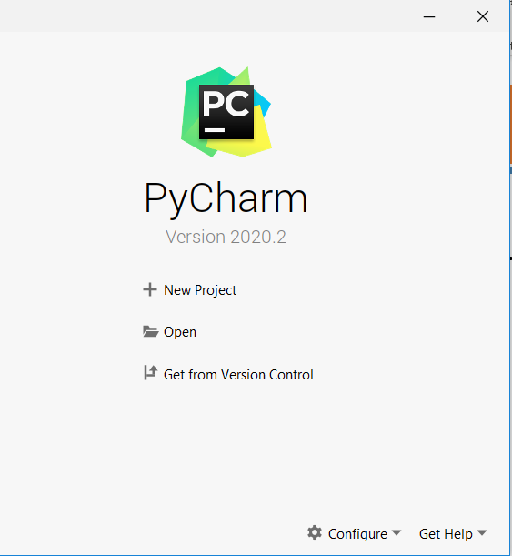
Getting to know PyCharm
Create a new 'Pure Python' project
(without the start screen: choose menu item File > New Project...)
Notes:
Slides 15 till 18 explain the creating of a new Python project, this will be covered during our face-to-face session organised at the campus.

Slide 16
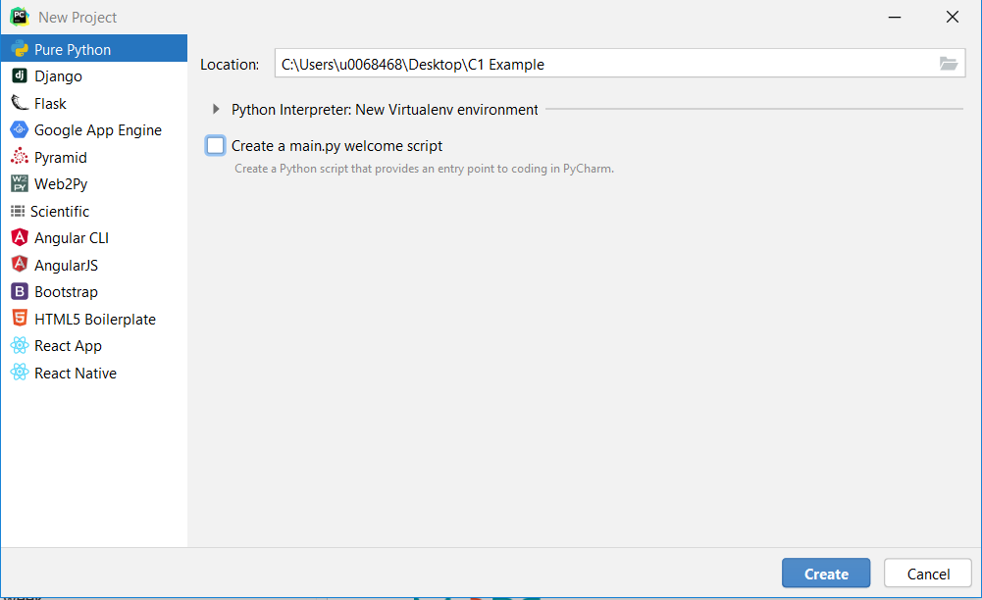
Getting to know PyCharm
Choose the location of the project
Add the project name: C:\Users\u0068468\Desktop\C1 example
Tick off ‘Create a main.py welcome script’
Click Create
(first time: please be patient...)

Slide 17
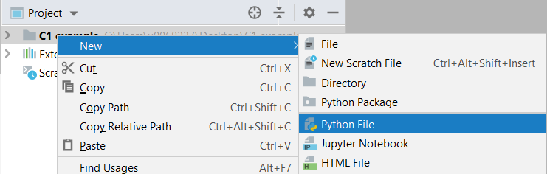
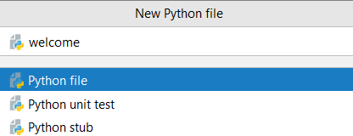
Getting to know PyCharm
Now add your first Python File to the project.
Right click on C1 example
Choose New
Choose Python File
Call it welcome
Press Enter

Slide 18
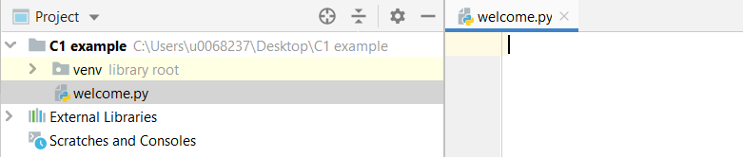
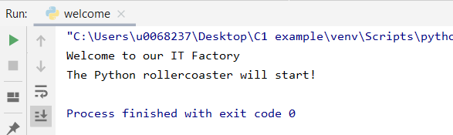
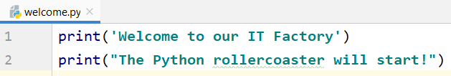
Getting to know PyCharm
Result
Now code your first 2 lines of Python code Output screen
Function print() provides printing on console.
The text you want to print is between (single or double) quotes.
Notes:
In the py file ‘welcome’ two instructions are included. PyCharm will execute as a sequence both instructions, one after the other. First line 1, then line 2.
The function ‘print’ coloured blue, sends the data to the output screen. The data displayed in the screen colors green and is captured by single or double quotes.

Slide 19
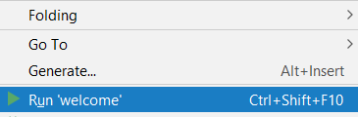
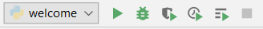
Getting to know PyCharm
Execute the code
First time: via the right mouse button menu
Next time: same way or click the run-button
Result:
Notes:
The following slide shows the result of the executed code in the output screen.

Slide 20
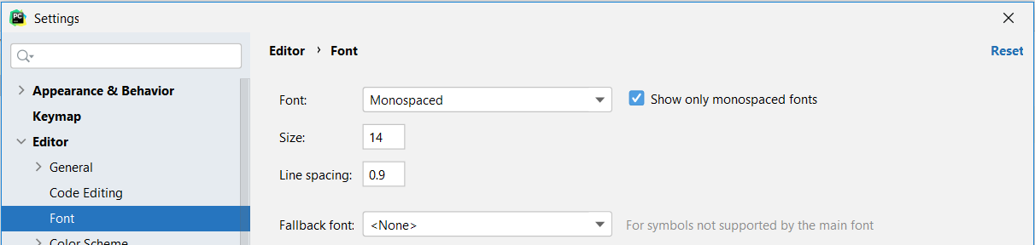
Getting to know PyCharm
TIP: You can adjust the color settings, font, point size, ... of the IDE to your own preference via the Settings page (File > Settings or Ctrl + Alt + S).
Problems with the Interpreter can also be solved in that Settings screen.
Notes:
You can personalize your development environment via the ‘settings’.

Slide 21
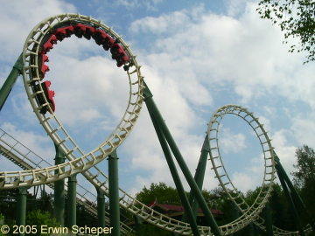
Example: roller coaster.py
Calculate the average speed of the Python roller coaster in the Efteling
Length of the roller coaster = 750m
Duration of the trip = 2 minutes
Notes:
The second example calculates the average speed of the Python roller coaster in the Efteling. The largest theme park in the Netherlands. Approximately 60 km away from Geel.
The following assumptions are made. The length of the roller coaster equals 750 metres and the duration of one ride takes 2 minutes.
To calculate the average speed in kilometres per hour we divide the length in km by the duration in hours.

Slide 22
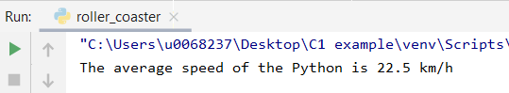
roller_coaster.py
Code:
Result:
Line 1
Line 2
Line 3
Line 4
length_in_km = 0.750 time_in_hours = 2/60 speed = length_in_km/time_in_hours print('The average speed of the Python is ' + str(speed) + ' km/h')
Notes:
To calculate the result we add 4 lines of code to our py file. Note, each instruction is written on a different line. And each line will be executed sequentially one after the other. On line 4 you recognize the ‘print’ instruction, to send the data to the output screen. As you can see, the average speed of the roller coaster equals to 22.5 km/h. More detailed informed will be given on the next slide.

Slide 23
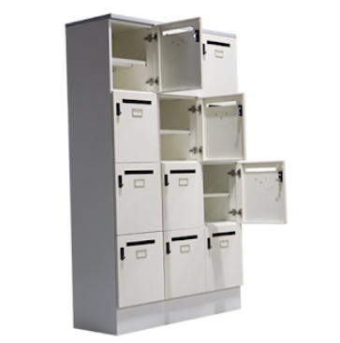
roller coaster.py
Line 1
Line 2
Line 3
Line 4
length_in_km = 0.750 time_in_hours = 2/60 speed = length_in_km/time_in_hours print('The average speed of the Python is ' + str(speed) + ' km/h')
length_in_km
time_in_hours
speed
variables
/ real division
+ addition
see further
/
+
operators
print (argument)
str (argument)
functions
Notes:
From line 1 to line3 we have declared the variables length_in_km, time_in_hours and speed. If we want to use data such as the length and time in our program we need to store this data in the computer’s memory. You can compare the memory of the computer with a large cupboard of mailboxes where you can store data in each mailbox. To post data in the mailbox you need to name each mailbox. So each mailbox needs a label or name so that you are sure that you address the right mailbox. This mailbox we call a variable where you can store data. So length_in_km, time_in_hours and speed are variables were we can store data. You can assign data to the variable via equals to. In the variable length_in_km we store the value 0.750, line 1 The same for the variable time_in_hourse, here we store the value 2/60, line 2. In the third variable, line 3 speed, we store the result from the division of the length and the time, 22.5km/h. So to collect the data from the mailbox we can use the name of the variable. We collect 0.750 divide this value by 2/60 and we store the result 22.5 in the variable speed.
In line 4 we send the result to the output screen. The green coloured text will be displayed literally, the average speed of the Python is. Next we at the result of the calculation, 22.5 via the variable speed. Finally we add the text ‘km/h’. We can use the plus sign to merge the different parts of the result.
We can also use the usual operators we know from Math like plus minus divided by and so on…
Note the function str(), we will explain this function more in detail later on.

Slide 24
Variables
Programs process data.
Data is stored in the computer's working memory.
The memory can be compared to a huge wall of mailboxes in which you can post mail.
If these mailboxes do not carry labels with an address, then it is an impossible task to post each letter correctly.
In the same way, it is necessary that every data stored in memory is given a label (an address): the variable!
The variable refers to a value in memory via the assignment operator (=).
Notes:
On this slide you can find an overview of the variables as explained in the previous slide.

Slide 25
Naming variables
We work according to the 'Google Style Guide' for Python:
Variables start with a letter
Variables consist only of lower case letters, numbers and underscores (_)
No abbreviations are used
Underscores are used to separate words
Use (long) meaningful names
length_in_km
time_in_hours
speed
variables
Notes:
For the naming of the variables we are going to apply some rules.
Use underscores to make your names readable like time_in_hours
No names like x,y,z… we use meaningful names such as length_in_km

Slide 26
Schematic
Variables in the program
Locations in working memory
=
float
length_in_km
0.750
float
time_in_hours
2/60
string
roller_coaster
python
length_in_km = 0.750 time_in_hours = 2/60 roller_coaster = "python"
Notes:
This slide shows an overview of the variables in the program and the working memory that is used to store the data. In the variable length the value 0.750 is stored via the assignment sign equals to (=). Note that is a decimal number represented by the type float in Python. The same for the variable time which also holds a decimal number 0.03. In this example we have a third variable roller_coaster which holds the text value ‘Pyhton’. This is a different kind of variable of the type ‘string’. In strings we store data with which we don’t want to make calculations. So in the scheme we have used to types of variables, float an string.
To summarize a variable has a name, we can store data in this variable from a specific type such as e.g. float (decimal number) and string (text).

Slide 27
Data type of a variable
Each variable refers to a value in memory
This value is always of a certain type
You can query the type with the function type()
Variable |  | Data type | Meaning
number = 5 | type(number) | int | Integer - Whole number
pi = 3.14159 | type(pi) | float | Floating Point - Real number
name = "Bob" or name = 'Bob' | type(name) | str | String - Text
success = True | type(success) | bool | Boolean - True of False
Notes:
Each variable has a name and a type, in the previous slide we have seen the datatype float for decimal numbers and the datatype string for text.
In the table an overview of the most common datatypes is displayed.
e.g. number = 5 if we apply the function type to the variable with name number the datatype int or integer is shown.
The variable pi contains the value 3.14159 which is a decimal number, so the datatype is float
The variable name contains the value ‘Bob’ which is text and is represented by the datatype ‘str’ or string.
The 4th variable success represents a Boolean or bool in Python and contains either True or False.

Slide 28
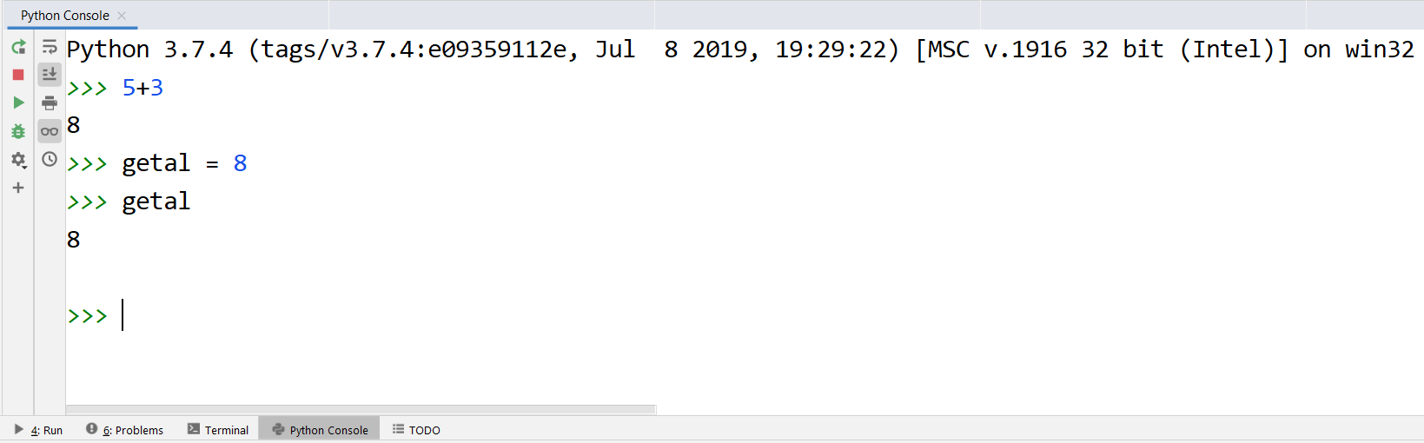
Python Console
To quickly test the capabilities of Python, you do not always need to write a full program.
You can also enter statements directly into the Python Console (click on Python Console at the bottom left).
Attention! These statements will not be kept.
If you see >>> before a statement in the slides,
it means it's entered in the console.
Notes:
If you want to quickly test some instructions, you don’t always have to create a new py file. You can also test some statements directly into the Python console. Note, that this statements will not be saved! We will demonstrate the use of the Python console during our face-to-face meetings at the campus.

Slide 29
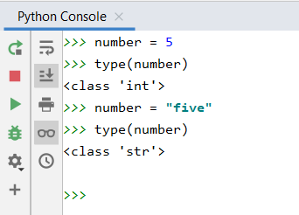
Dynamic typing
Attention! The data type of a variable can change throughout a program.
Variable in the program
Locations in working memory
=
int
number
5
string
five
Notes:
A strength of Python is dynamic typing. Throughout the exectution of the program the datatype of a variable can change.
e.g. number = 5 the datatype of number is integer
Next number = ‘five’ the datatype of number changes into string

Slide 30
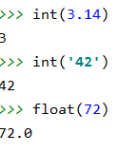
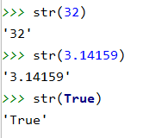
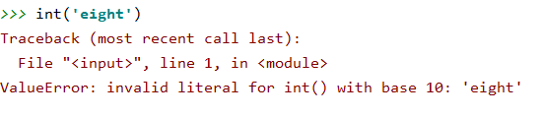
Type conversions
Each Python data type has a function that converts an argument to this data type
int(argument) converts argument to data type int
float(argument) converts argument to data type float
str(argument) converts argument to data type str
If the argument cannot be converted to the data type you will get an error 'at runtime'.
Notes:
We can use type casting or type conversions to change the datatype of a variable. The function int changes the datatype of the variable to integer, float to float (decimal number) and str tot sting (text).
e.g. int(3.14) changes 3.14 into an integer 3 (whole number)
e.g. str(32) changes 32 into a string (text, captured by single or double quotes)
e.g. the third box: int(‘eight’) we can’t convert text into an integer, so the program generates an error!

Slide 31
Type conversions
Line 1
Line 2
Line 3
Line 4
length_in_km = 0.750 time_in_hours = 2/60 speed = length_in_km/time_in_hours print('The average speed of the Python is ' + str(speed) + ' km/h')
str(speed) changes data type from float to string This conversion is necessary because the print function can only print strings!
Notes:
On line 4 we have used the function (str) to convert the float datatype of the variable speed into a string. This is necessary because the print function can only print strings. The variable speed’s datatype is float and has to be changed via a conversion function.
As told before, the plus sign is used to merge the different string parts. This is also called concatenation. (joinging strings)
Note the we have added blanks after the s of the word ‘is’ and before the k of ‘km/h’, this is really necessary to obtain the displayed output.

Slide 32
Arithmetic operators
operator | description
() | parentheses
** | power
+x -x | positive, negative number
* / // % | multiplication, real division, whole division, remainder
+ - | addition, subtraction
Operators are listed in the table according to the respected order of operations. Operations are performed from left to right.
Notes:
Mathematical operators
/ Real division -> decimal number as result
// Whole division -> whole number as result

Slide 33
Arithmetic operators
Order of operations is respected
Note that the result of a real division ( / ) is always a real number (datatype float)
Line 1
Line 2
Line 3
>>> 1+2*3/4
2.5
>>> (1+2)*3/4
2.25
>>> 3**2/3
3.0
Notes:
Line 1 2*3=6/4=1.5+1=2.5
Line 2 (1+2) =3 *3 = 9/4 =2.25 (real division -> decimal number as result -> float)
Line 3 3**2=9/3=3.0 (real division -> decimal number as result -> float) (3 to the 2nd power)

Slide 34
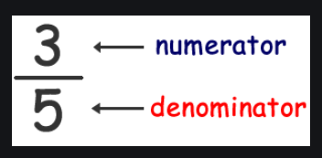
Division
Python distinguishes real division from whole division
operator / calculates real division (always produces float)
operator // calculates quotient (whole division)
modulo operator % calculates remainder after (whole) division
10
Line 1
Line 2
Line 3
Line 4
Line 5
>>> 83 / 10 # real division
8.3
>>> 83 // 10 # whole division
8
>>> 83.0 // 10 # whole division
8.0
>>> 83 // 10.0 # whole division
8.0
>>> 83 % 10 # remainder after division (modulo)
3
8
Notes:
/ Real division -> decimal number as result
// Whole division -> whole number as result
Line 3 if the numerator (83.0) or the denominator is a decimal number this will always lead to a decimal number as result (float) 8.0
Line 4 if the numerator or the denominator(10.0) is a decimal number this will always lead to a decimal number as result (float) 8.0
Line 5 we calculate the remainder after the whole division (//) which will lead to an integer (3)

Slide 35
Operators for strings
operator | description
+ | concatenation of strings
* | number of string repeats
length_in_km = 0.750 time_in_hours = 2/60 speed = length_in_km/time_in_hours print('The average speed of the Python is ' + str(speed) + ' km/h')
>>> 'Ha' * 3
HaHaHa
Notes:
Beside the mathematical operators we also have operators we can use for strings.
+ to concatenate or merge strings (join)
to repeat strings

Slide 36
Shorthand operators
Standard operator
Shorthand operator
>> number = 6
>> number = number + 1
>> number
7
>> number = 6
>> number += 1
>> number
7
>> number = 4
>> number = number * 2
>> number
8
>> number = 4
>>> number *= 2
>> number
8
>> text = "Python"
>> text = text + " rules the world!"
>> text
'Python rules the world!'
>> text = "Python"
>>> text += " rules the world!"
>> text
'Python rules the world!'
Notes:
We can also use shorthand operators.

Slide 37
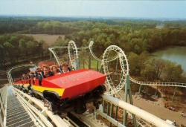
capacity.py
Calculate the capacity per hour of the Python roller coaster in the Efteling at maximum occupancy.
2 trains
28 seats by train
Boarding time = 30 seconds
Duration of the trip = 2 minutes
Notes:
Third example to calculate the capacity per hour at maximum occupation.

Slide 38
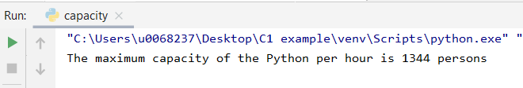
capacity.py
Code:
Result:
places_per_train = 28 trains_per_hour = 2 minutes_per_ride = 2 minutes_boarding_time = 0.5 capacity_per_hour = trains_per_hour * places_per_train
* 60 / (minutes_boarding_time + minutes_per_ride) print('The maximum capacity of the Python per hour is’,
int(capacity_per_hour), 'persons')
Notes:
5 variables have been declared to calculate the capacity per hour.
Alternative concatenation sign is the comma, which will also merge the different parts but also automatically converts the parts to string -> so int(capacity) will automatically be converted to a string. When you use the plus sign to concatenate this will not be the case and you will have to add the str() function.
print('The maximum capacity of the Python per hour is', int(1344.0), 'persons') print('The maximum capacity of the Python per hour is '+ str(int(1344.0))+ ' persons')

Slide 39
capacity.py
print('The maximum capacity of the Python per hour is’,
int(capacity_per_hour), 'persons')
An alternative print function is used (comma’s and not +)
The capacity_per_hour is converted to an integer. Otherwise the result would be: 1344.0 persons
Notes:
print('The maximum capacity of the Python per hour is', int(1344.0), 'persons') print('The maximum capacity of the Python per hour is '+ str(int(1344.0))+ ' persons')

Slide 40
capacity.py
Calculate the capacity per hour of the Python roller coaster in the Efteling at maximum occupancy.
2 trains
28 seats by train
Boarding time = 30 seconds
Ride time = 2 minutes
What if the number of seats per train or the number of trains used varies?
Are we going to write a new algorithm every time?
No! The solution is to request the number of seats and the number of trains
Notes:
In the previous example we have made some assumptions, now we want to change the number of seats and the number of trains, do we have to change our program every time? NO, we are going to ask the user to enter the number of seats and of trains.

Slide 41
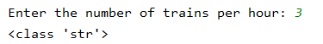
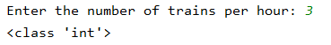
Input function
input(argument) built-in keyboard input function
the value entered is captured in a variable
input always returns a string
So, when you request a number, you still have to convert the string you entered using the conversion functions float() or int() before you start calculating with it.
Line 1
trains_per_hour = input("Enter the number of trains per hour: ") print(type(trains_per_hour))
Line 2
trains_per_hour = int(input("Enter the number of trains per hour: ")) print(type(trains_per_hour))
Notes:
We ask the user to enter a value via the input function. The text given as argument (captured by parentheses) and captured by double or single quotes is the text that will appear in the screen. Enter the number of trains per hour: The user enters a number e.g 3 (colours green).
The entered value will be stored in the variable trains_per-hour with the datatype string as you can see in the first box. To summarize the input function always returns a string.
Line 2 you need a number because you want to use that number in your calculations than you need a string, but input returns a string so you need to convert into an integer as you can see in line 2.
So don’t forget to put a variable before your input function, if not you will loose the entered value, you need to store the value!

Slide 42
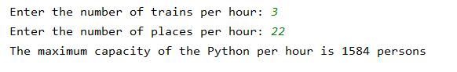
capacity.py
Code:
Result:
trains_per_hour = int(input("Enter the number of trains per hour: ")) places_per_train = int(input("Enter the number of places per hour: "))
minutes_per_ride = 2 minutes_boarding_time = 0.5
capacity_per_hour = trains_per_hour * places_per_train * 60 / (minutes_boarding_time + minutes_per_ride)
print('The maximum capacity of the Python per hour is', int(capacity_per_hour), 'persons')

Slide 43
Comments in a Python program
Adding comments makes your program more readable for other programmers
In Python
You can
Type # manually
Select lines code > menu Code > Comment with Line Comment
Select lines code > press ctrl + /
#strings can be with "" or ' text1 = "this is in the morning" text2 = 'start lesson 8:25' #join strings print(text2, text1)

Slide 44
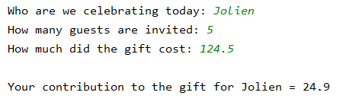
Recap
Many programs have the following structure:
You read data
You process those data
You print the information you obtained
# read data person = input("Who are we celebrating today: ") number_of_guests = int(input("How many guests are invited: ")) price_present = float(input("How much did the gift cost: "))
# process data price_per_guest = price_present/number_of_guests
# print information print("\nYour contribution to the gift for " + person + " = " + str(price_per_guest))

Slide 45

Recap
The new line character in Python is \n .
It is used to indicate the end of a line of text and the beginning of a new line

